Slide 1



Innovation.
Education.
Training.

Slide 2





INNOVATION.
EDUCATION.
TRAINING.
Hello
Tampa

Slide 3

Transform and Upload: DMF Tips and Tricks to get the most out of the DMF

Slide 4



Speaker, and Special Thanks
Nathan Clouse
Technical Architect
Microsoft MVP 5x
Armanino

Slide 5
Data Management Framework
DMF
Data migration
Integration
Power BI
Configurations
Apps
Automation
Reporting
Excel
DMF can be used to import, export, and copy data into legal entities. DMF is purposefully designed to assist data migration in D365FO. DMF Can be used to import, export, copy data (setup and configurations) across legal entities, and integration. This can be used for high volume of data since it is compatible to be run through batch job.

Slide 6
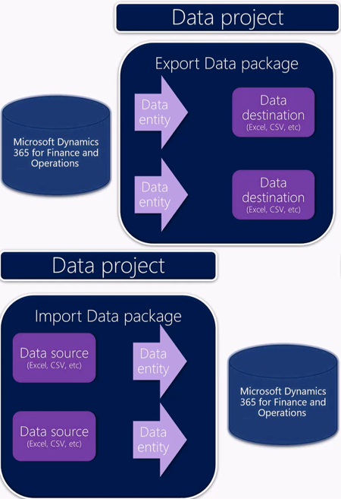
DMF
It is a useful tool to quickly migrate reference, master and document data from external systems to D365FO. DMF consists of the following concepts:
Data entities
Data package
Data project

Slide 7
Import / Export / Copy
Export / Import / Copy into legal entity
Templates
Filter
Mapping
Add criteria
Remove map for entity field(s)
Data Management
Import / Export
Data Projects
Job History
Configure entity to export to database /BYOD /Change tracking(Primary, Entire, Custom)
Recurring integrations
Sequencing
Data entities with a data package
Default
Custom
Golden Config
Module
Priority
Data Entities
Template
Dual-write

Slide 8
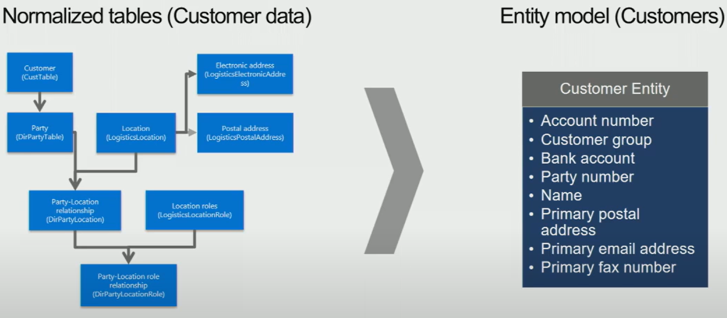
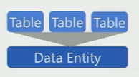
Data Entity
A data entity can be one or multiple tables enabling abstraction of internal interaction between tables.

Slide 9
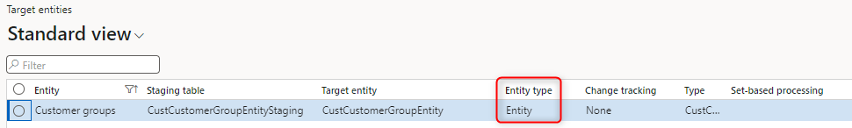
Simple Entity
A basic data entity that represents a single concept or entity in the system.

Slide 10
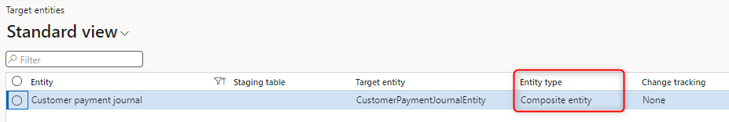
Composite Entity
It combines multiple related entities into a single entity

Slide 11
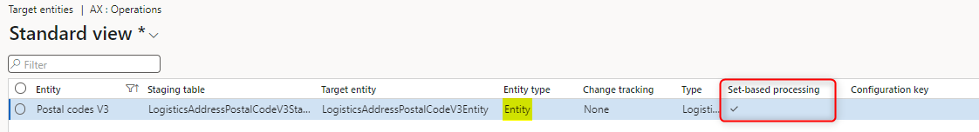
Set Based Entity
It is collection or set of records that share common characteristics or attributes. It enables operations and actions to be performed on a group of records simultaneously, improving efficiency and scalability in data processing.

Slide 12

Rows vs Sets
Rows
1 collection at time
Targeted
Precise
Slow (comparatively)
Sets
Collections of Collections
Targeted
Precise
Fast (comparatively)

Slide 13
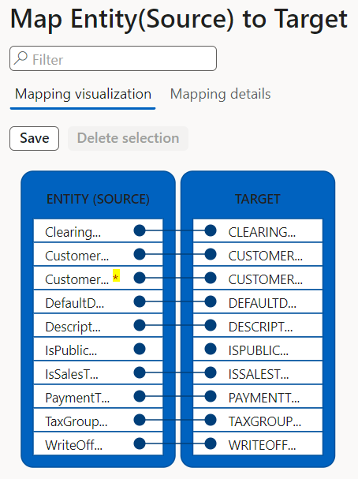
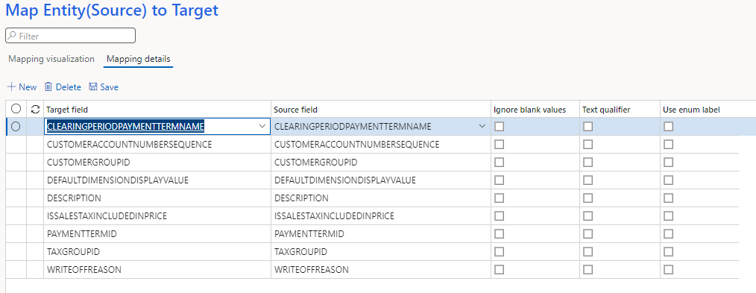
Mapping

Slide 14
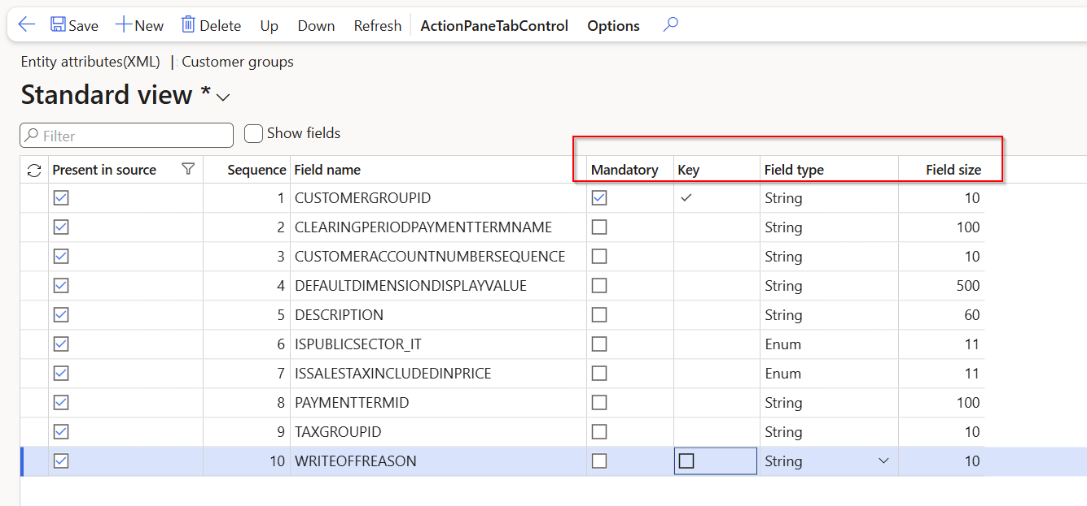
Entity Attributes

Slide 15
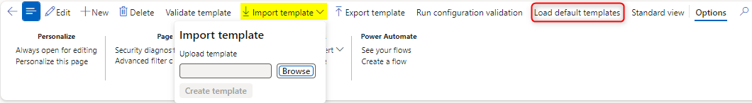
Templates

Slide 16
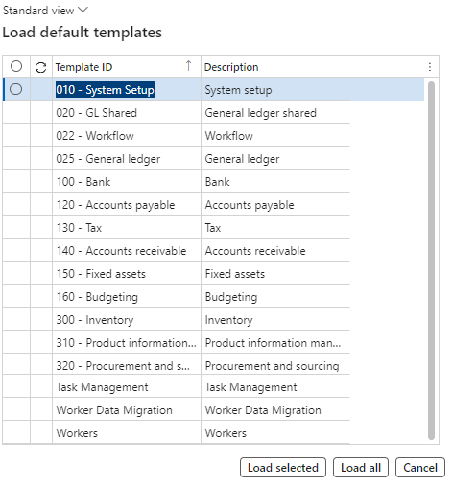
Templates

Slide 17

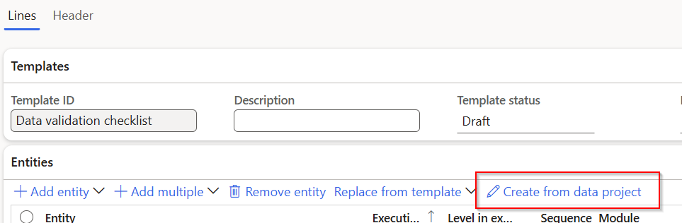
Templates

Slide 18
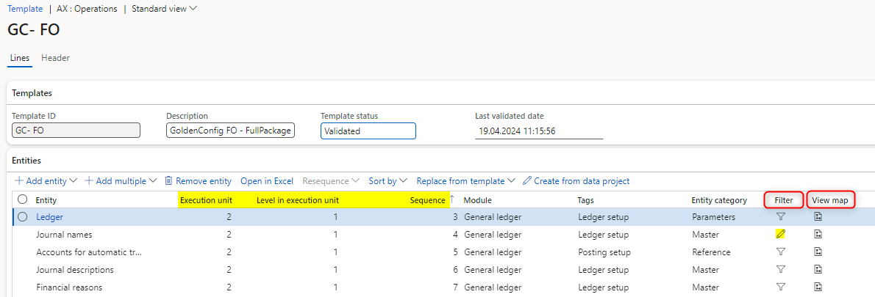
Sequence

Slide 19
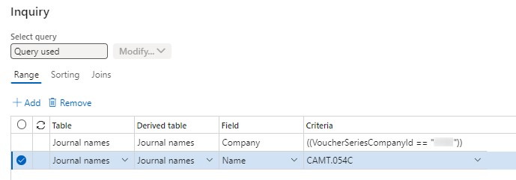
Filter

Slide 20
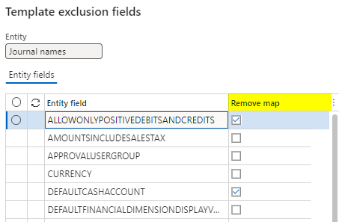

Map

Slide 21
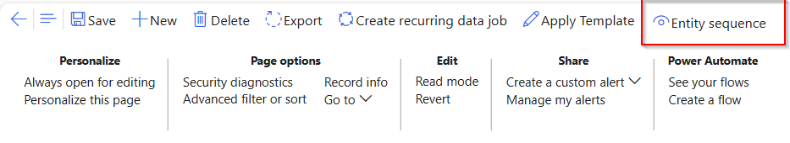
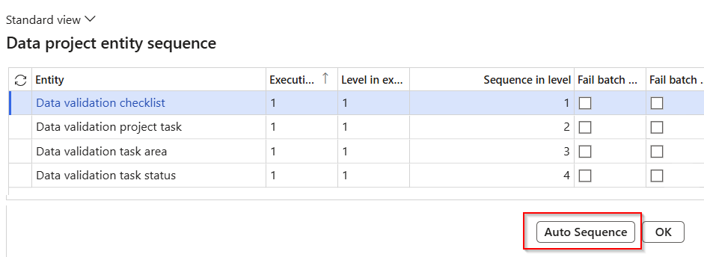
Auto Sequence

Slide 22
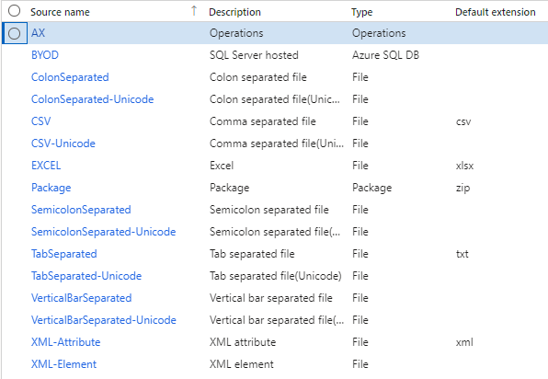
Data Formats

Slide 23
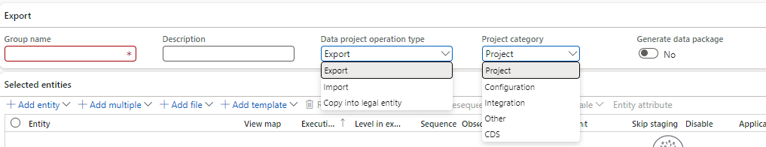
Project Types
Import
Export

Slide 24
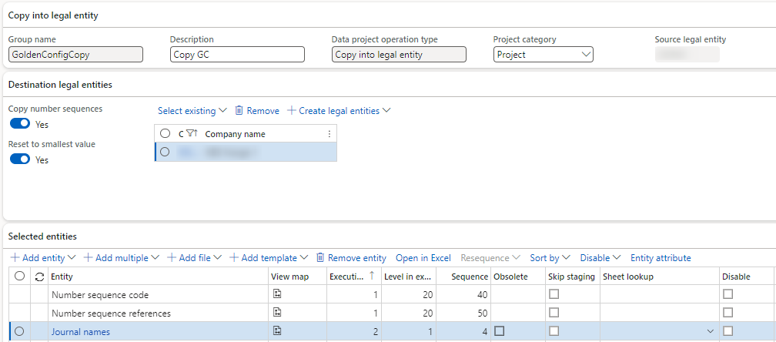
Project Types

Slide 25

Source, Staging, and Target
Methods
2
Staging
Target
Source
1
Source to staging
Staging to target

Slide 26
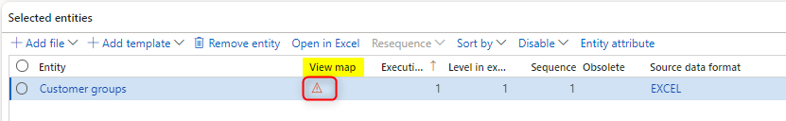
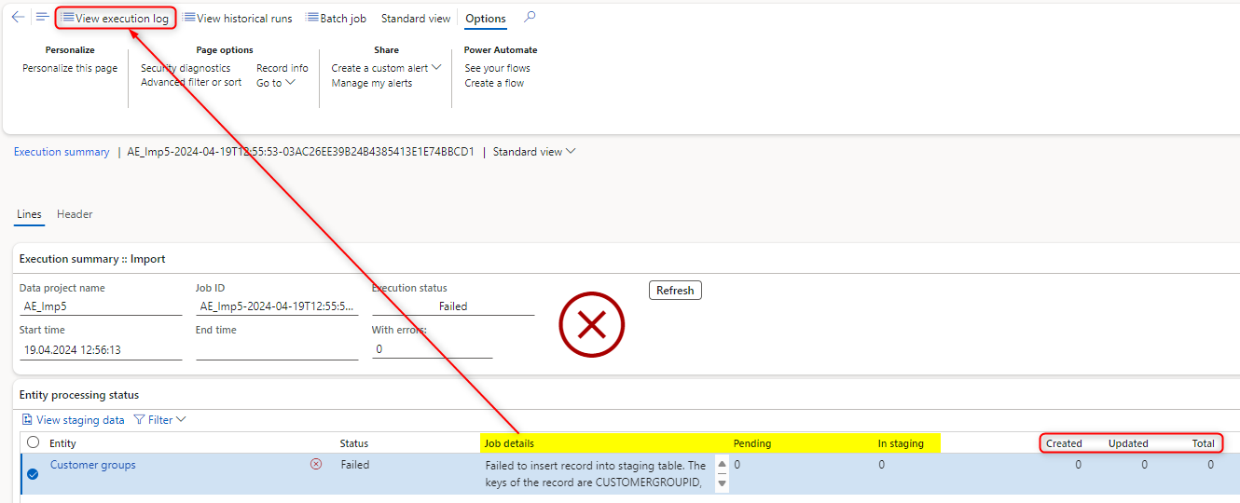
Troubleshooting

Slide 27
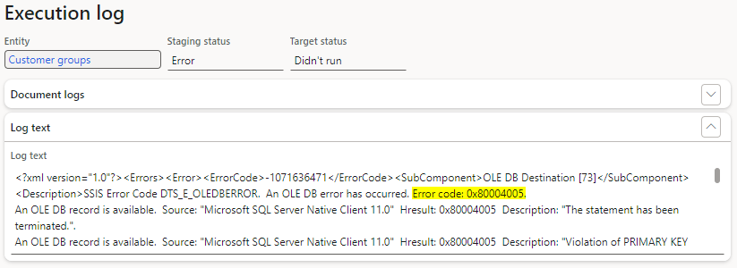
Troubleshooting

Slide 28
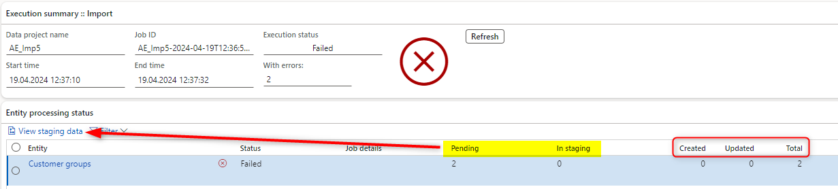
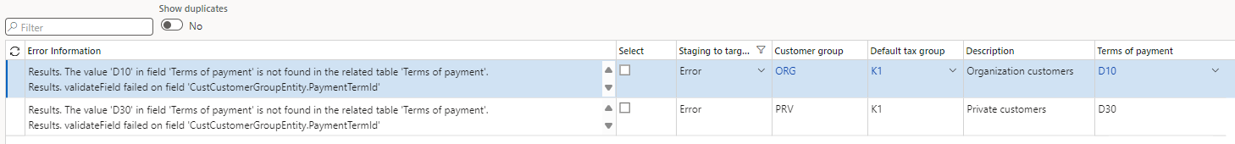
Troubleshooting

Slide 29
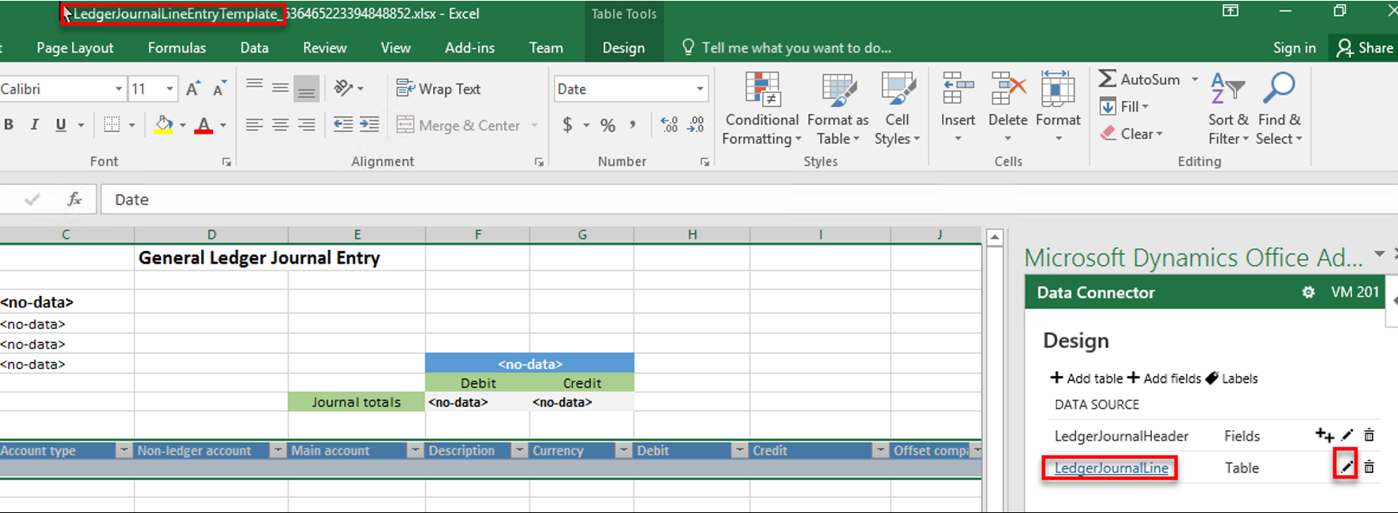
Excel Add-in
Notes:
https://community.dynamics.com/blogs/post/?postid=8e7e7ae9-954f-41d6-bc28-540199109729

Slide 30
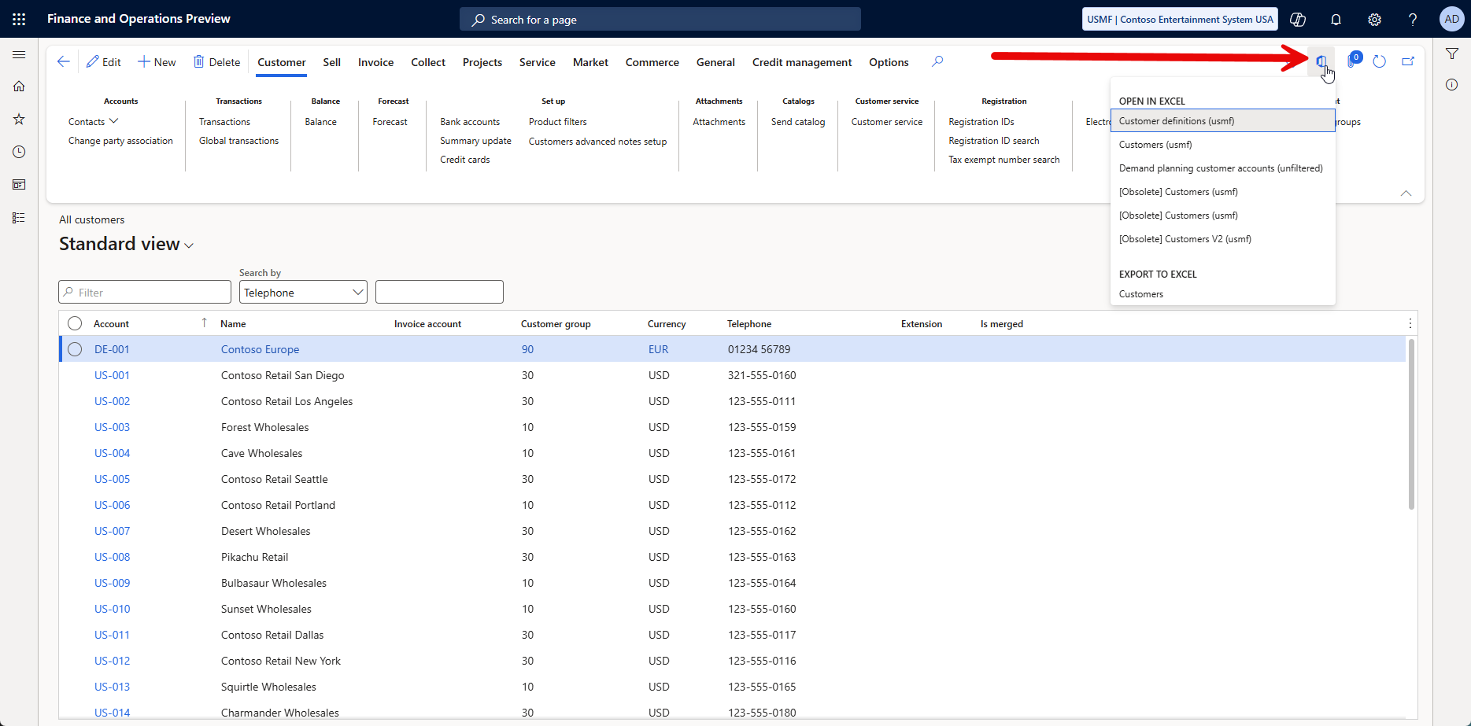

Slide 31
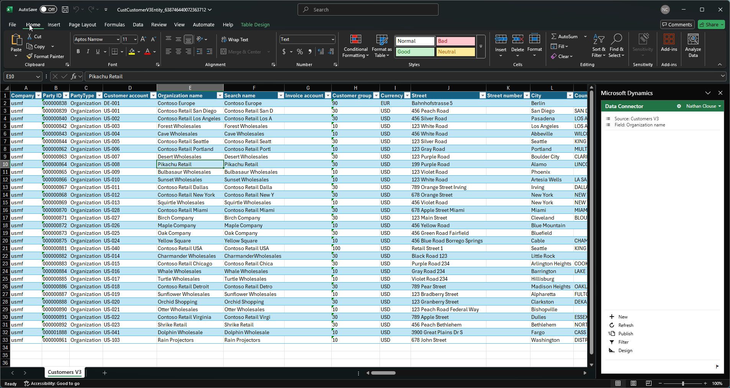

Slide 32
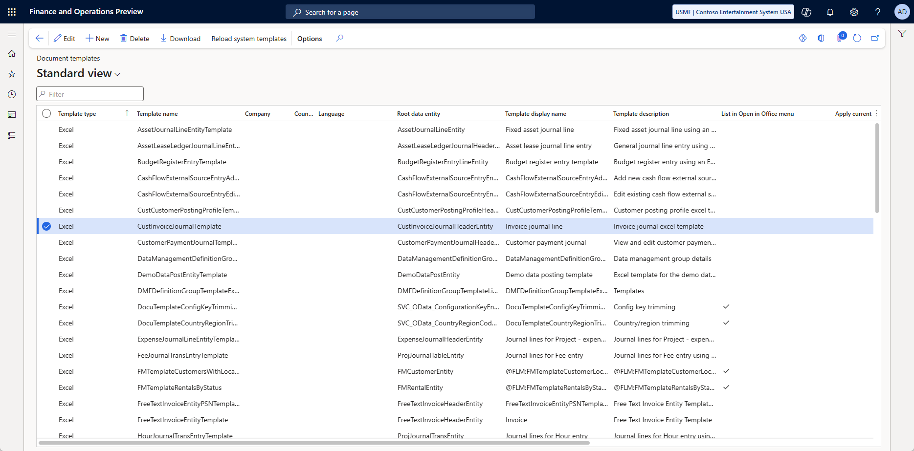
Document Templates

Slide 33
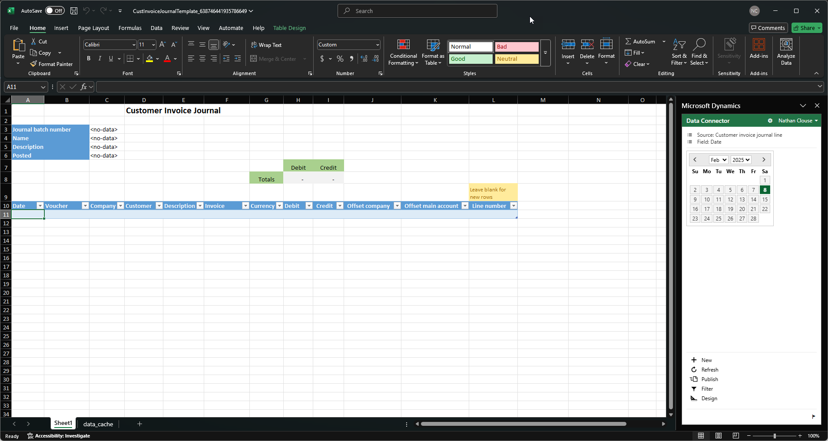

Slide 34
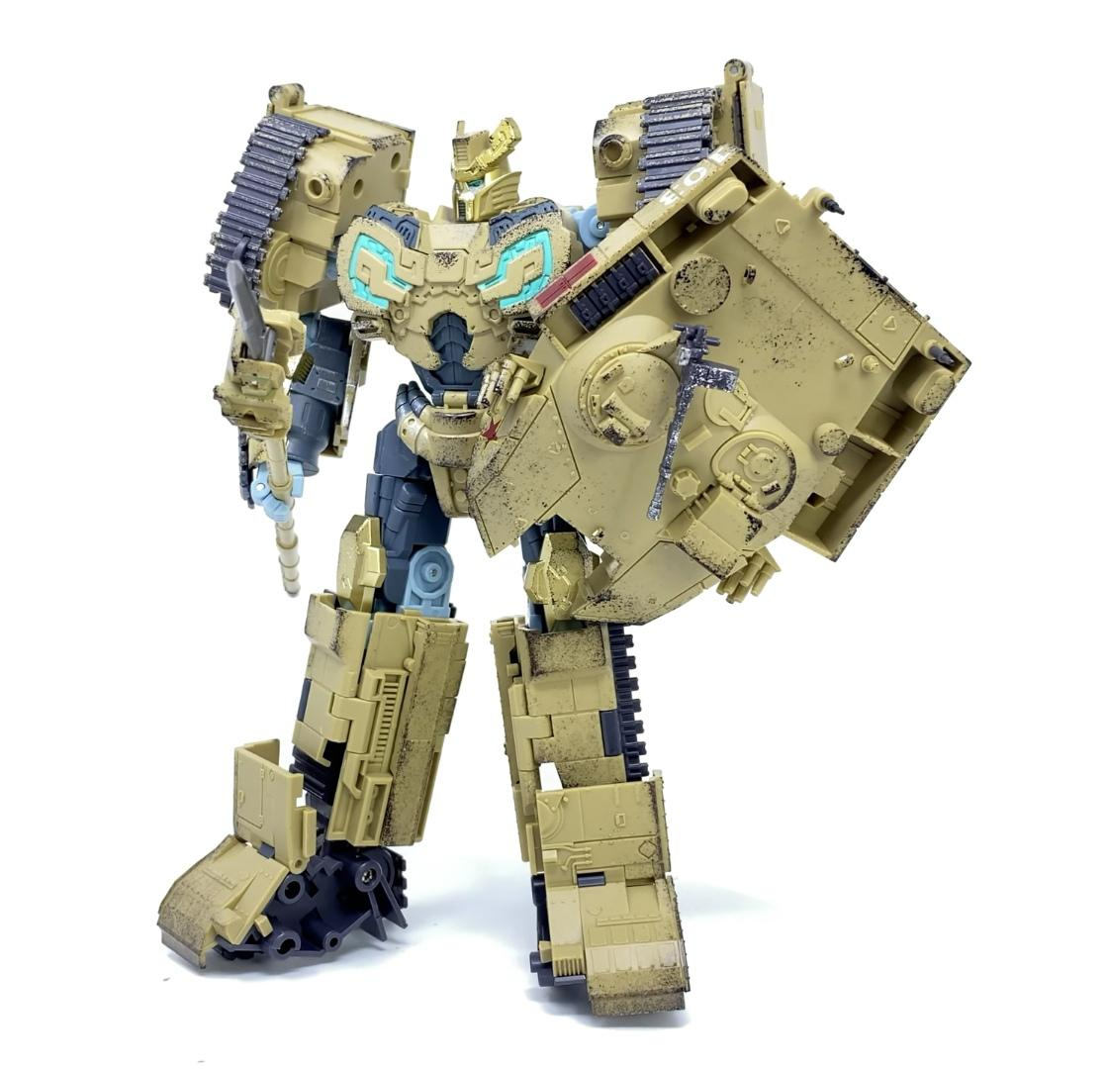
Paste in Grid
Copy/Paste for Grids
Export all rows, make changes, paste back in

Slide 35
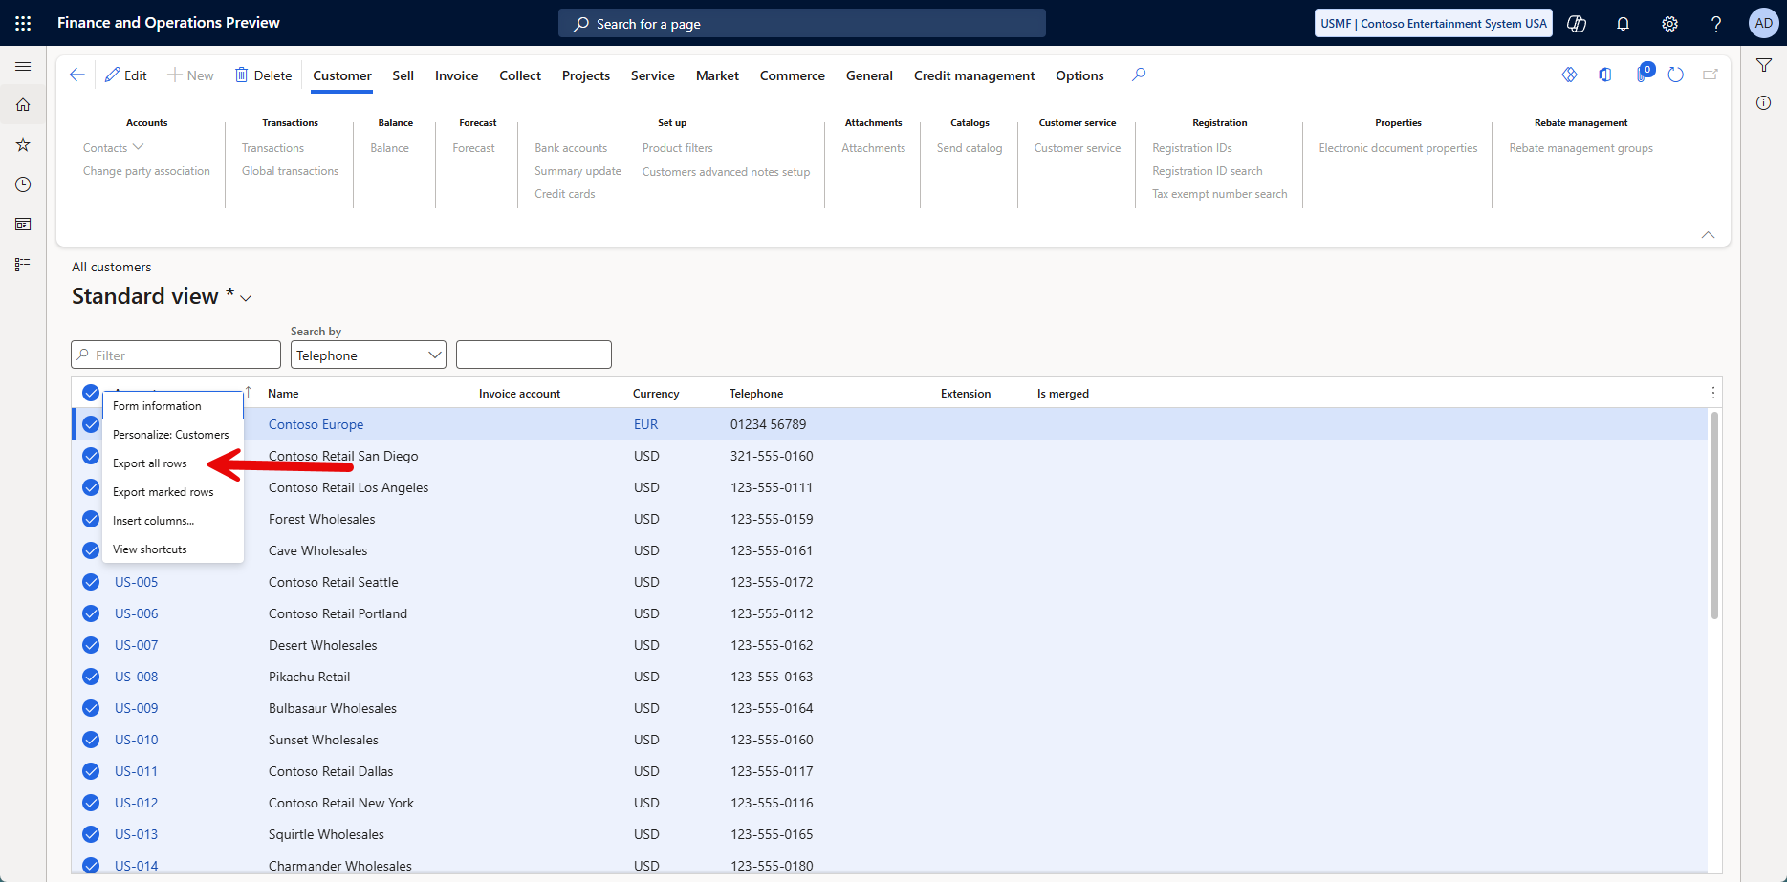

Slide 36
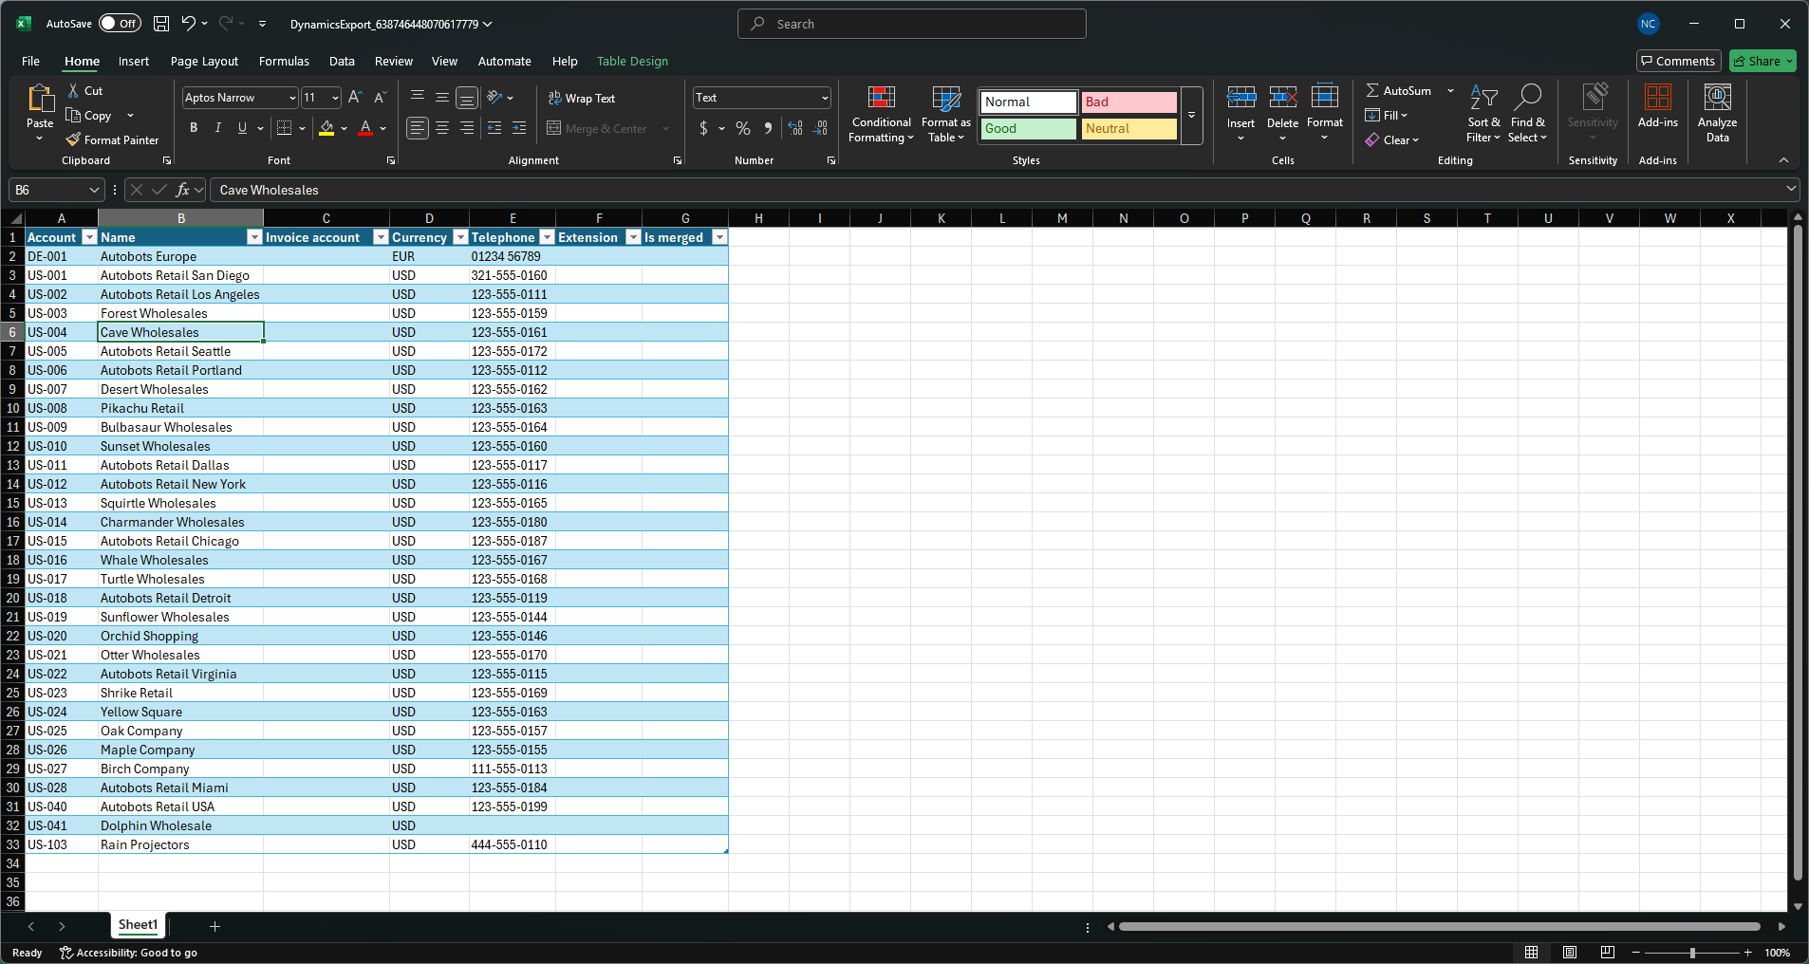
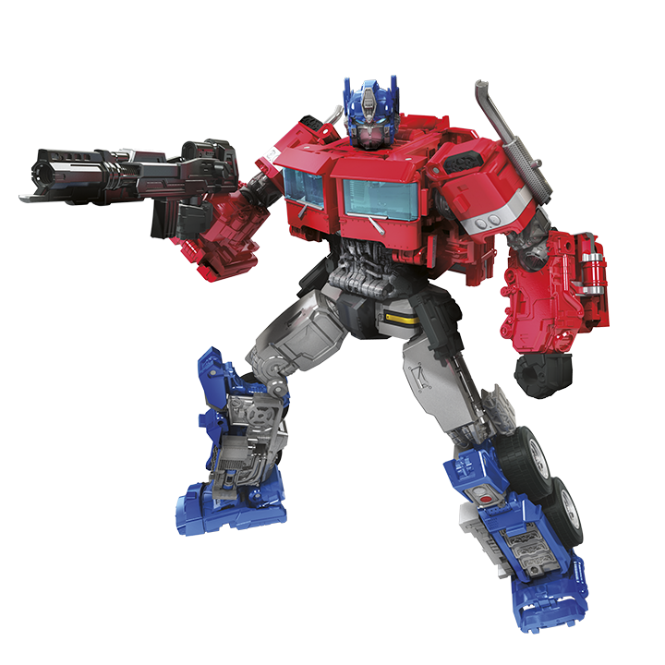

Slide 37
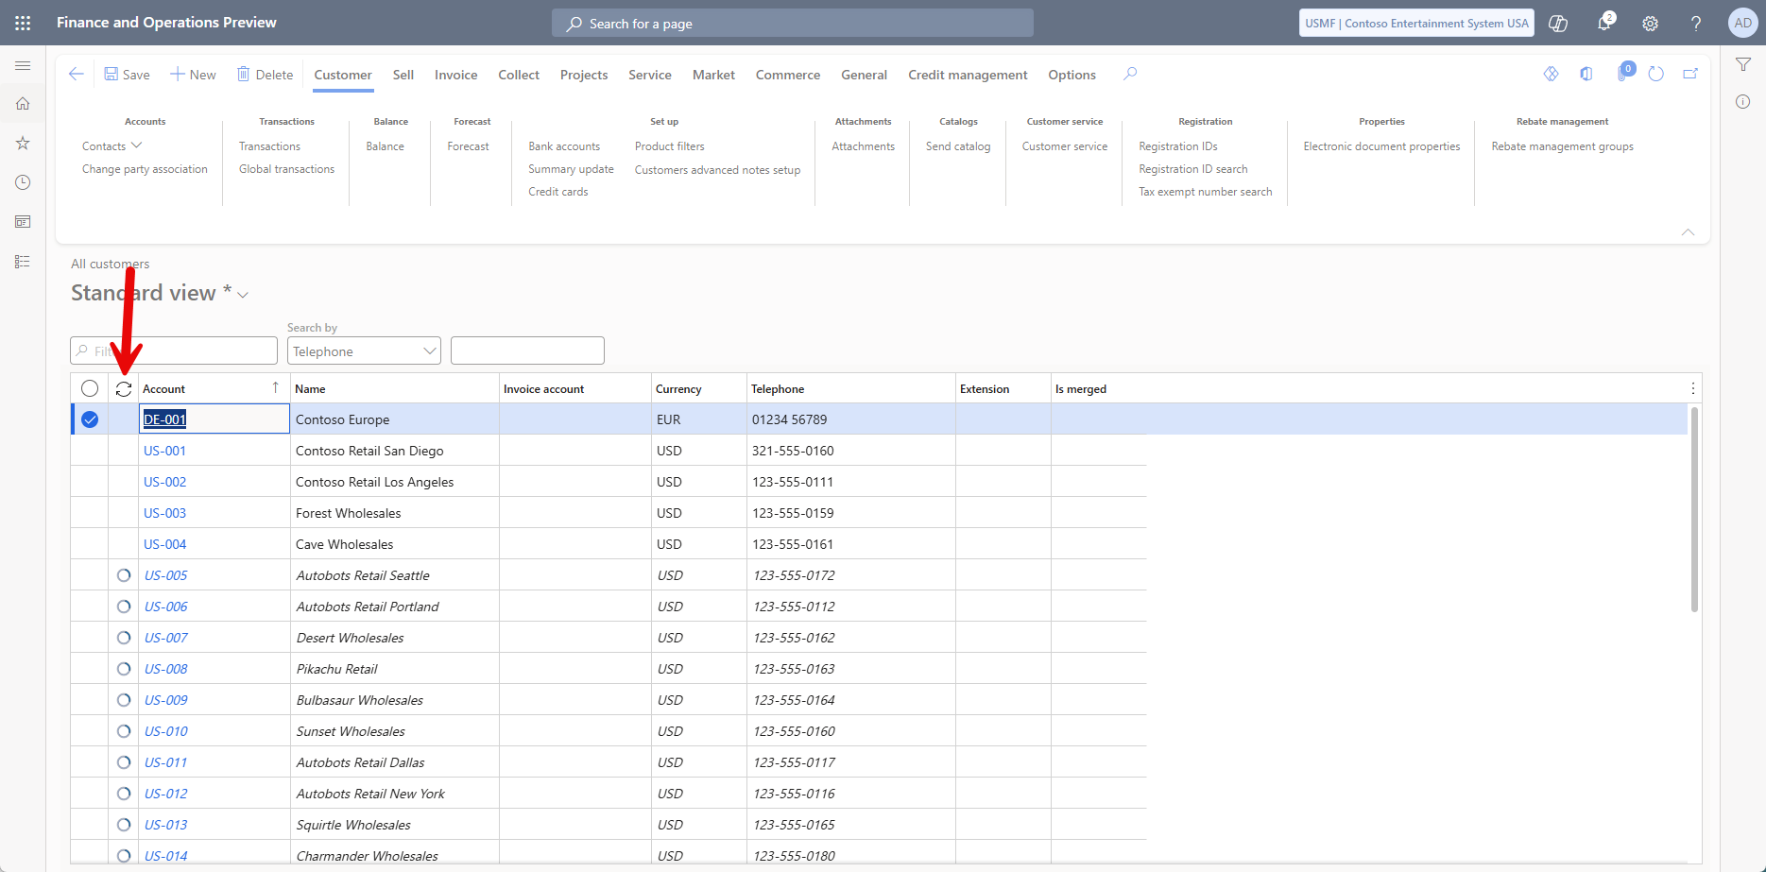
Notes:
Didn’t work, name in the grid is read only

Slide 38
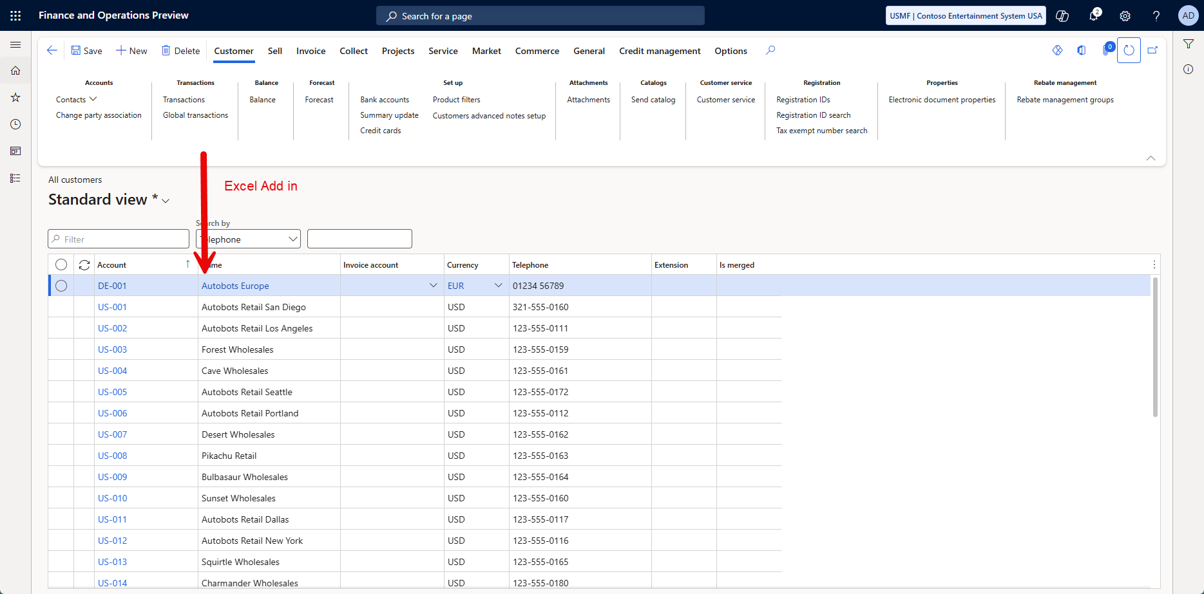
Notes:
Autobots were still able to roll out with Excel Add in

Slide 39
Integration
Synchronous
Data entities allow for the exposure of public application programming interfaces (APIs) on entities, facilitating synchronous services. These synchronous services serve various purposes, including Office integration and third-party mobile applications. Synchronous integrations stand out for their ability to provide real-time data exchanges.
Asynchronous
It is designed for scenarios where an immediate response isn't critical, primarily focusing on handling large volumes of data. Some examples include interactive file-based import/export and recurring integrations via files or queues.

Slide 40
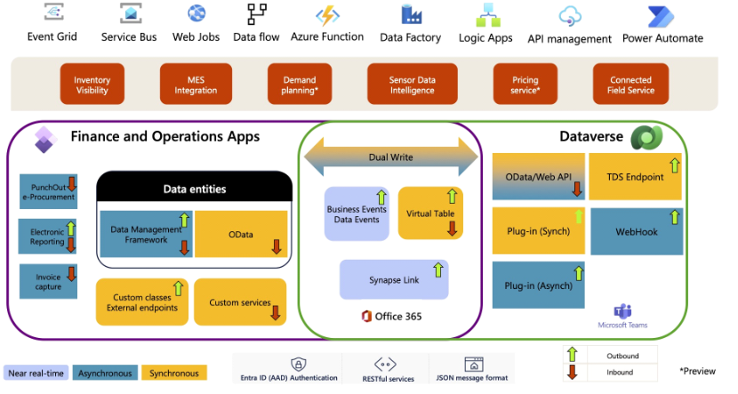

Slide 41
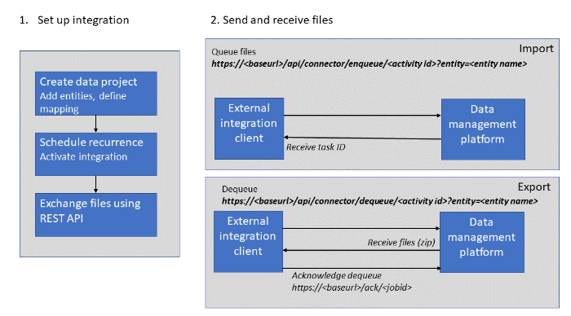
Recurring Integrations

Slide 42
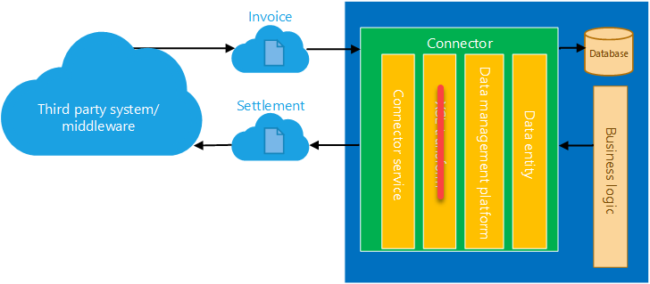

Slide 43
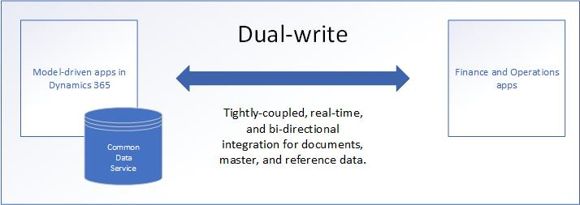
Dual Write

Slide 44
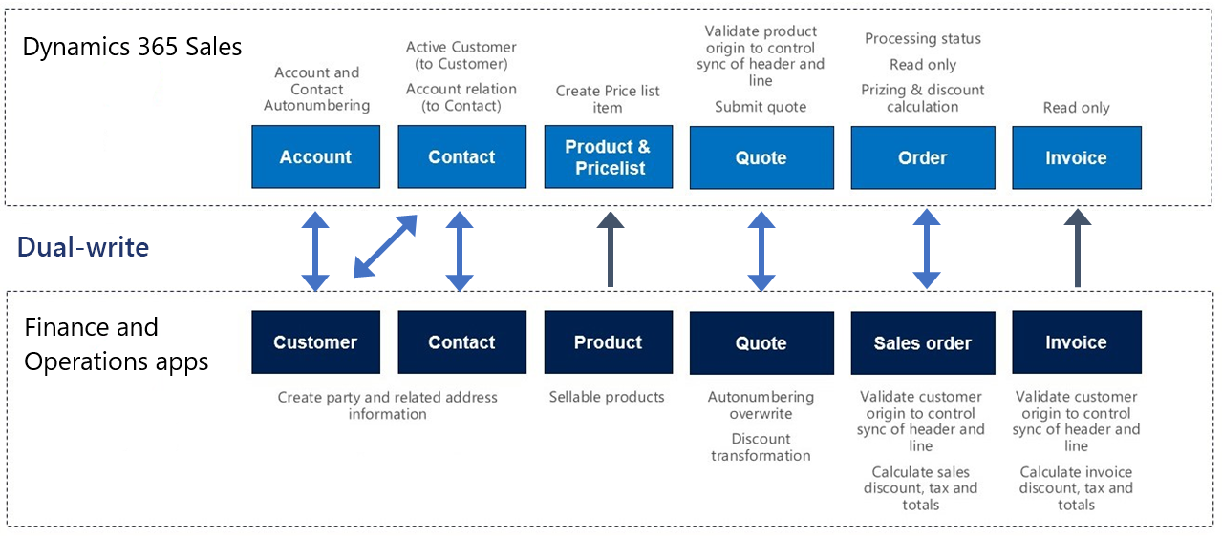

Slide 45
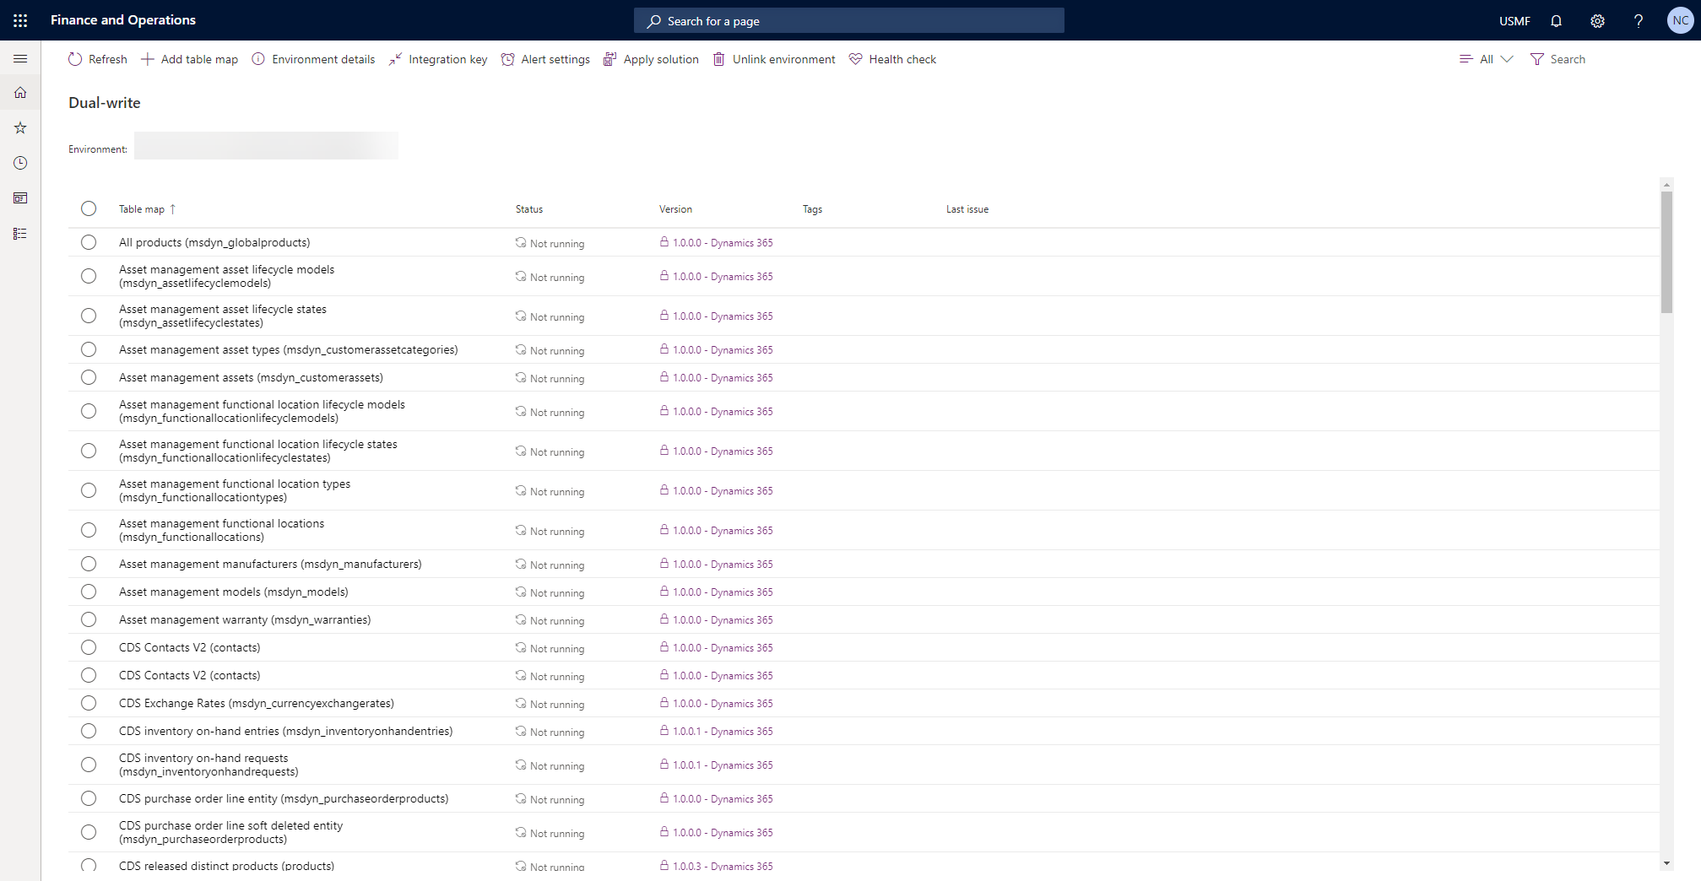

Slide 46
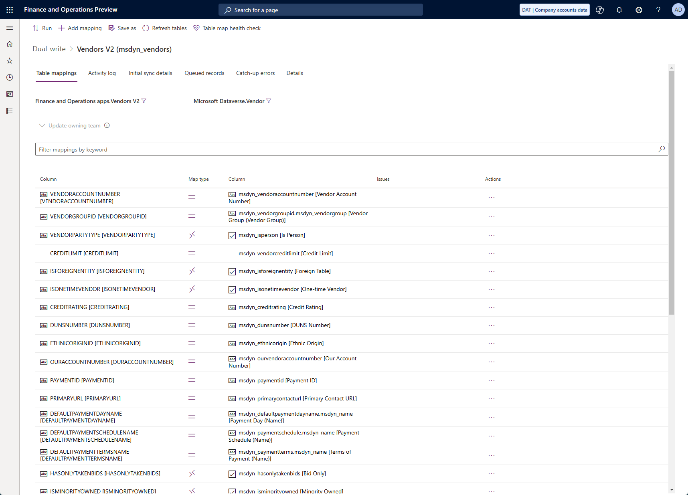

Slide 47
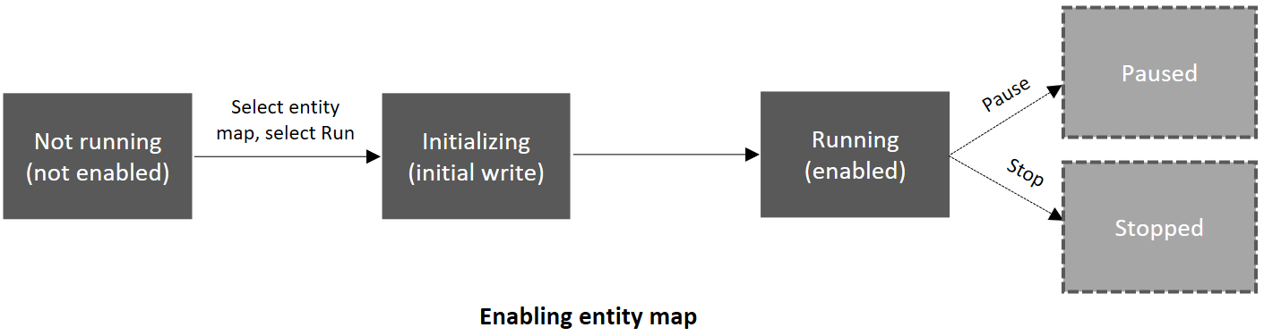

Slide 48
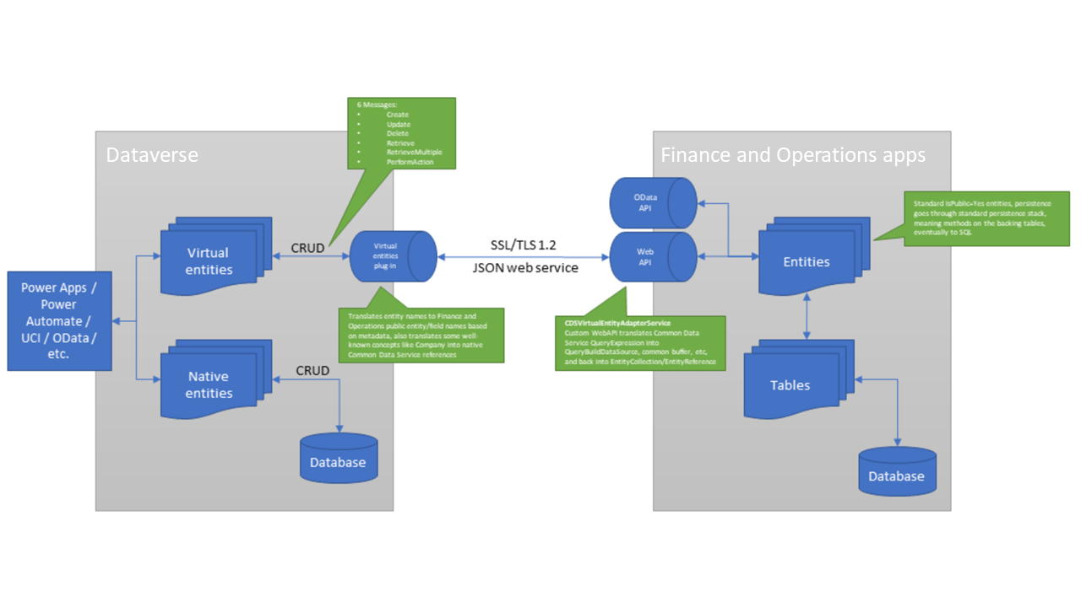
Virtual Entities

Slide 50




Bringing It all Together
Power Automate sends to F&O
Vendor Signup Form
Output in Excel
New Unapproved Vendor

Slide 51


Bringing It all Together
Export DMF Package
Unzip, Send to Sharepoint
Notes:
Mention change tracking

Slide 52
Other Things we could automate?

Slide 53
Thank you!
Nathan Clouse
Armanino, nathan.clouse@armanino.com

